Slide 1
Convolutional Neural Networks
John Robinson
Mentored By: Dr Girard

Slide 2
Problem Description
Develop a image recognition neural network using a convolutional neural network.

Slide 3
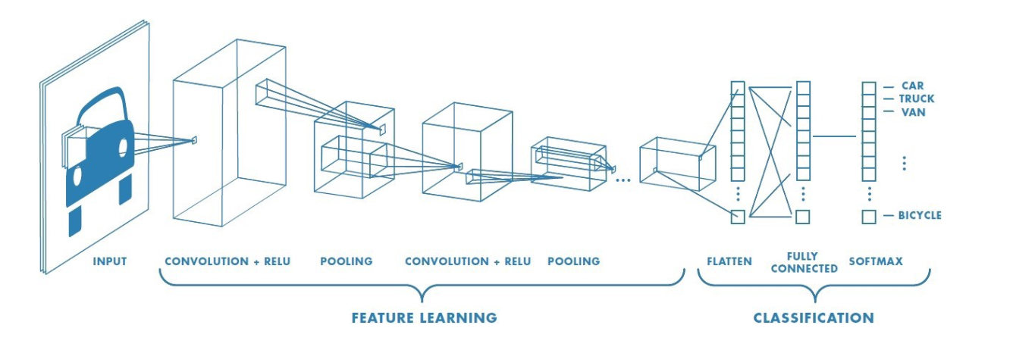
Background: Convolutional Neural Network Overview

Slide 4
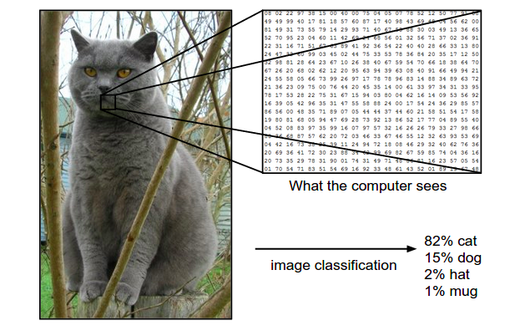
Input Layer

Slide 5
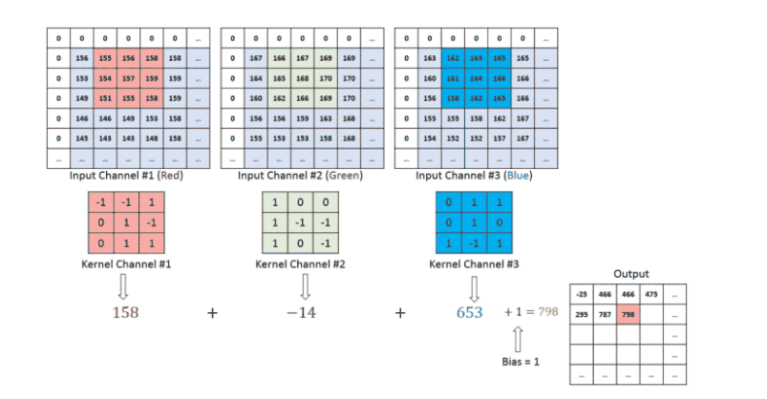
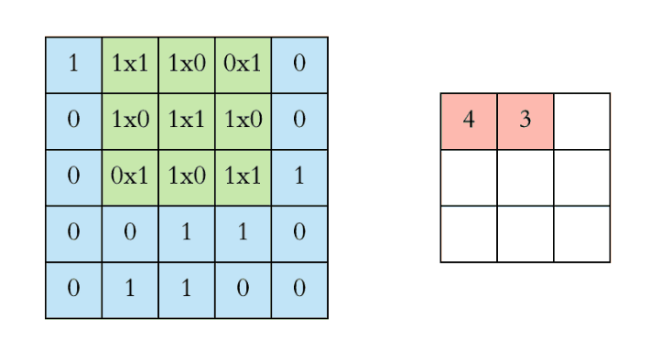
Convolution Layer
The objective of the Convolution Operation is to extract the high-level features such as edges, from the input image
Notes:
Stride, kernel, rgb vs greyscale
The objective of the Convolution Operation is to extract the high-level features such as edges, from the input image.
the first ConvLayer is responsible for capturing the Low-Level features such as edges, color, gradient orientation.
ith added layers, the architecture adapts to the High-Level features as well.
Maybe mention zero padding

Slide 6
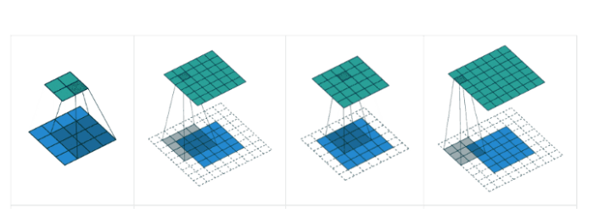
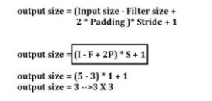
Convolution Layer Cont.
Padding used to add extra pixels, usually zeros to allow for a closer analysis of the input.

Slide 7
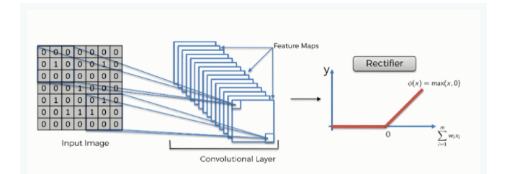
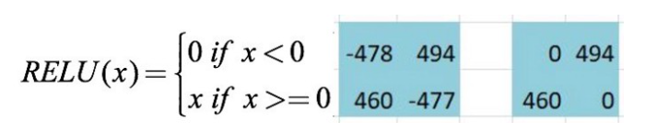

The Rectified Linear Unit: ReLU
ReLU is the max function(x,0) with input x e.g. matrix from a convolved image. ReLU then sets all negative values in the matrix x to zero and all other values are kept constant.

Slide 8
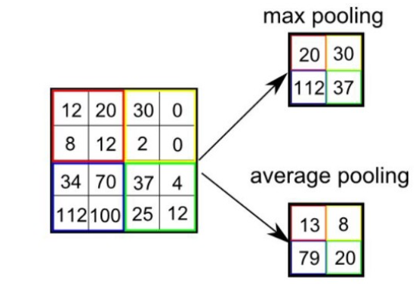
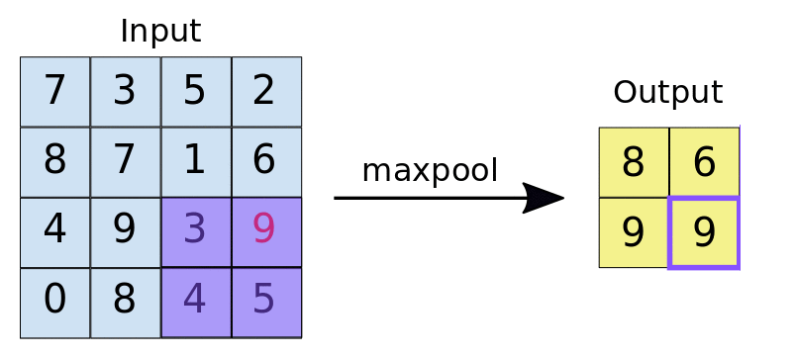
Pooling Layer
The function of pooling is to continuously reduce the dimensionality to reduce the number of parameters and computation in the network. This shortens the training time and controls overfitting
Most frequently used type of pooling is called Max Pooling and used to decrease feature map size while at the same time keeping the significant information.
Notes:
Also average padding in addition to max pooling which just averages instead of taking the max value.
Non overlapping

Slide 9
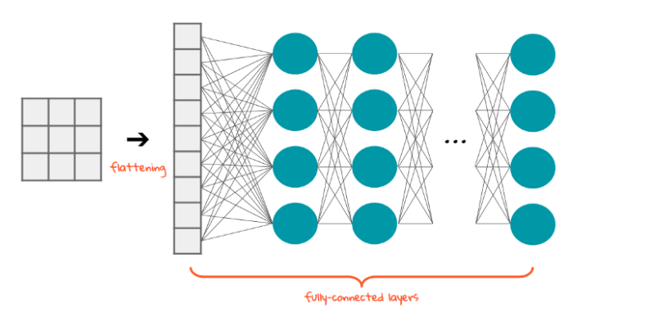
Classification: Flattening Layer
Flattening is the process of converting the result of the convolutional layers into a one dimensional array so that it can connect to the fully connected layer.

Slide 10
Fully Connected Layer
This point becomes a normal neural network with the flattened feature vector is in input for the neural network so must through process of forward and backward propagation
Numbers are randomly generated for bias and weight

Slide 11

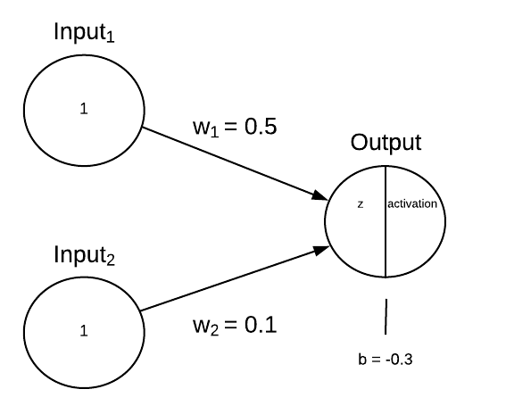


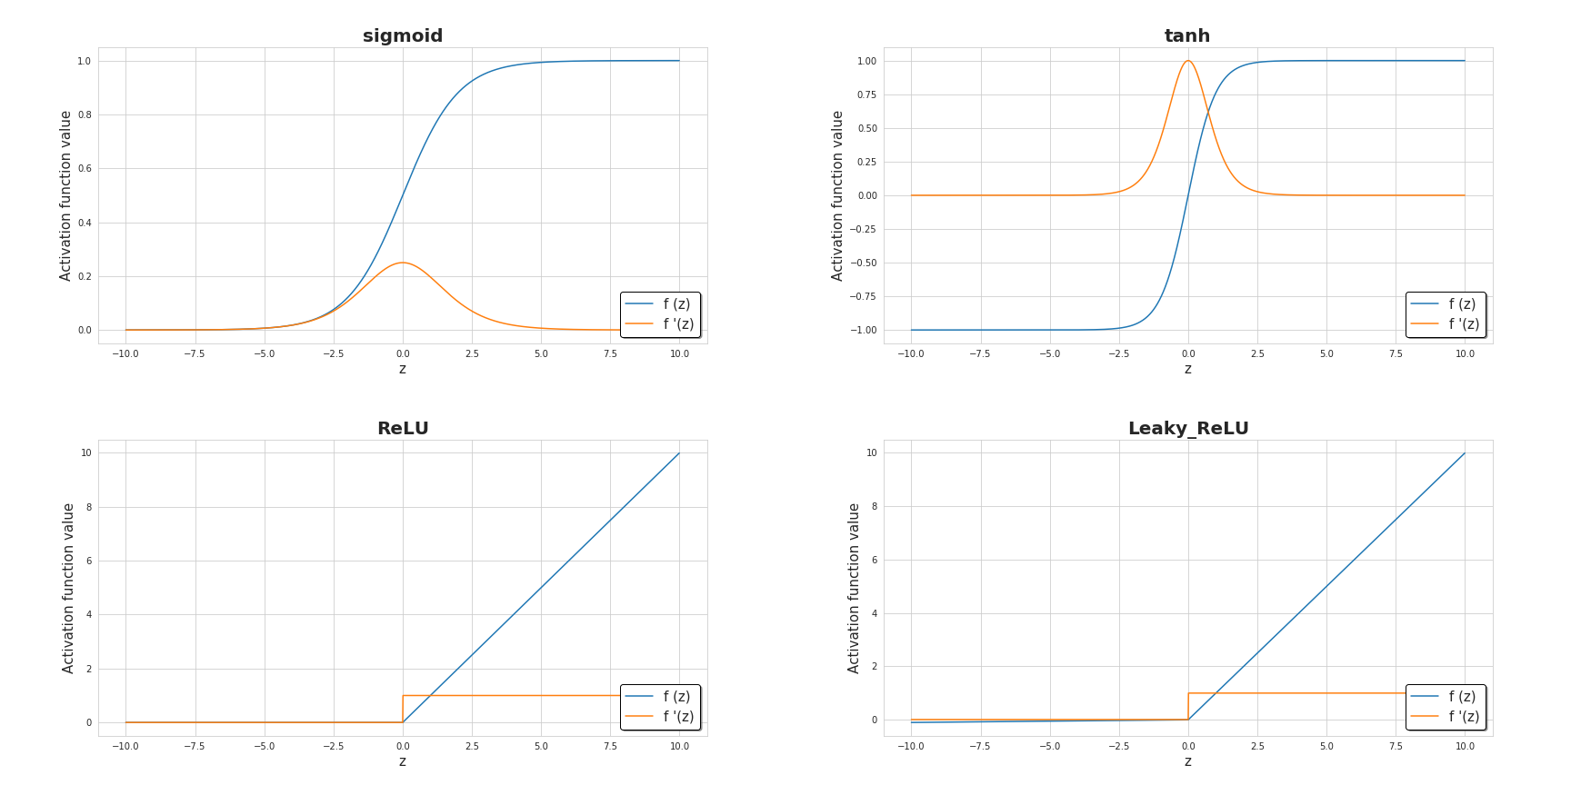
Forward Propagation
Notes:
Sum of previous node times the respective weights plus bias then plugged into activation function yields y this is done until
Actual vs predicted output

Slide 12
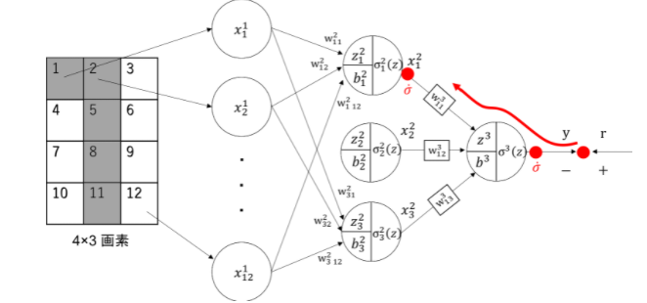
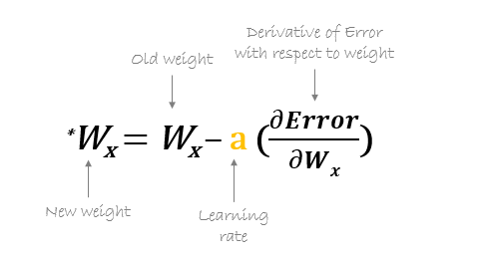
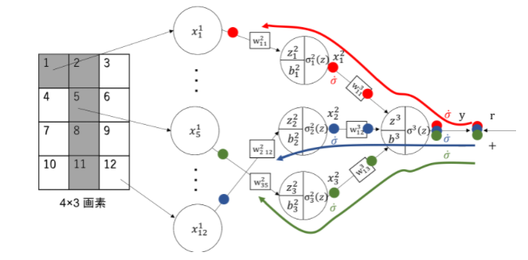
Backward Propagation Cont.

Slide 13
Primary Objective
How does filter size affect the ability to determine the age of a person with a CNN using UTKFace data-set.
Time Limit: 3 Person Weeks (120 hours)

Slide 14
Initial Hypothesis
A 3x3 filter will yield a higher accuracy than a 2x2 or 4x4 filter size.

Slide 15
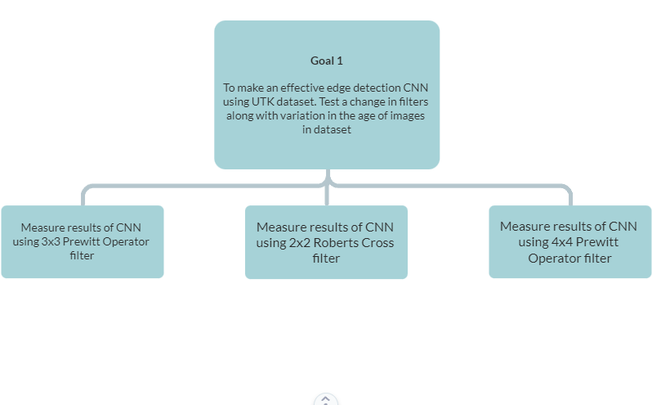
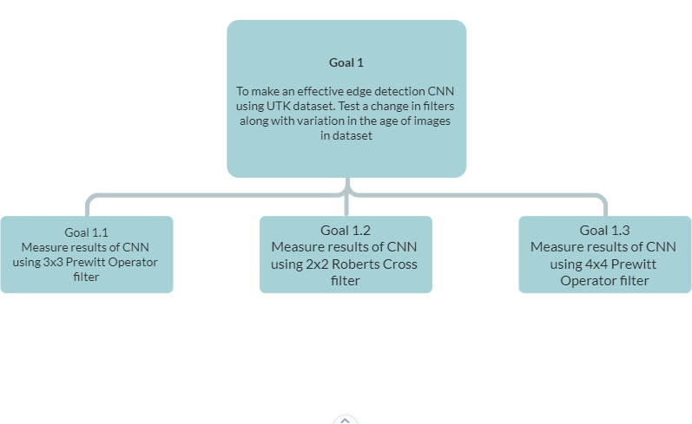
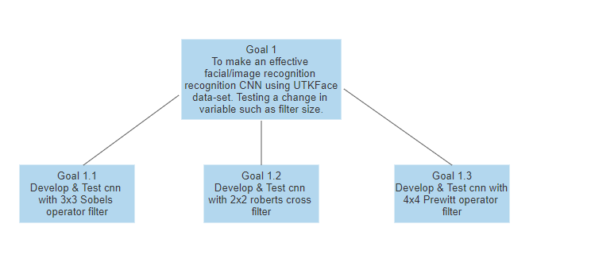
Goal Tree
Notes:
Measure results of CNN using XxX <filter name>. Change Goal 1.

Slide 16
Solution Description
The facial recognition CNN will be developed and trained in a python environment with filter sizes of 2x2,3x3,4x4. The kernels for each being the roberts cross for the 2x2, Prewitt for the 3x3 and Prewitt operator for the 4x4, these are also referenced in the figure below. Comparing resulting accuracy to find best results. The secondary variables will include the use of zero padding, one convolution layer, sigmoid activation function for the classification, one hidden layer in classification, and the use of max pooling.

Slide 17
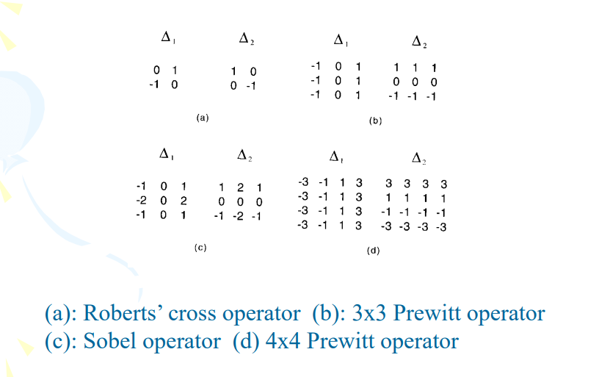
Solution Description
Notes:
If you can - edit out the ones not using.

Slide 18
Block Diagram
Factor | Values
Filter sizes | 2x2, 3x3, 4x4
Activation functions | Sigmoid (NN), RELU (CNN)
Images | Train with 20000 images Train with 18000 and test with 2000
Number of hidden layers in classification | 1
Number of Convolution Layers | 1
Padding Types | No Padding
Number of Pooling Layers | 1
Pooling Types | Max

Slide 19
Solution Description
Python using Jupyter Notebook were used to code and compile the convolutional neural network.
Created the Convolution layers and neural network layers from scratch, no packages apart from number generation and converting images to an array etc…
Tested CNN on UTK dataset. Dataset made up of faces from a range of ages, races and other distinguishing features.
Trained on 80% and tested on 20% of the data for each edge detection filter
Overall accuracy calculated based on number of correct guesses during testing

Slide 20
Experiment Design
Filters
3x3 Prewitt Operator:
[1,0,-1][1,0,-1],[1,0,-1]
[1,1,1],[0,0,0],[-1,-1,-1]
2x2 Roberts Cross:
[1,0],[0,-1]
[0,1],[-1,0]
4x4 Prewitt Operator:
[-3,-1,1,3],[-3,-1,1,3],[-3,-1,1,3],[-3,-1,1,3]
[3,3,3,3],[1,1,1,1],[-1,-1,-1,-1],[-3,-3,-3,-3]
UTK dataset 20000 images
100_1_0_20170117195420803.jpg
200x200 pixels grayscale
Age Range
0-17
18-30
31-61
61+
Notes:
UTKFace dataset is a large-scale face dataset with long age span (range from 0 to 116 years old). The dataset consists of over 20,000 face images with annotations of age, gender, and ethnicity. The images cover large variation in pose, facial expression, illumination, occlusion, resolution, etc. This dataset could be used on a variety of tasks, e.g., face detection, age estimation, age progression/regression, landmark localization, etc. Some sample images are shown as following

Slide 21
Experiment Design Cont.
Single Convolutional Layer
Activation, Pooling, Flattening, etc…
Single Hidden Layer
50 nodes
Sigmoid activation
Output Layer
4 nodes/4 possible answers
Sigmoid activation
Backpropagation
During Training 25 iterations
LR 0.2 and weights initialized at -0.01 to 0.01
Notes:
Flattening gives around 10k input nodes with 50 hidden layer nodes

Slide 22
Results
After training weights with 18000 randomized images in batches of 2000. Running the tests yielded the following results.
4x4: 66.13%
3x3: 61.07%
2x2: 66.49%
Standard Deviation:
4x4: 3.87523
3x3: 1.27782
2x2: 1.76757
Notes:
Need standard deviation to do any statistical analysis of the data.
Quarter of data set

Slide 23
Results Cont.
3x3
Age | Average | Std-Dev
0-17 | 1.09% | 0.2005384
18-30 | 63.94% | 8.8671832
30-61 | 79.57% | 3.183857
61+ | 7.53% | 2.526811
Age Groups | T test 4x4 and 3x3 | T test 4x4 and 2x2 | T test 2x2 and 3x3
0-17 | 0.0001 | 0.0001 | 0.0001
18-30 | 0.0003 | 0.0001 | 0.0001
30-61 | 0.0001 | 0.2380 | 0.0001
61+ | 0.0001 | 0.0001 | 0.0001
4x4
Age | Average | Std-Dev
0-17 | 6.79% | 1.563819
18-30 | 69.76% | 4.338735
30-61 | 81.69% | 3.07670
61+ | 21.80% | 5.16670
Accuracy based on age ranges:
4x4
0-17 6.79%
18-30 69.76%
30-61 81.69%
61+ 21.80%
3x3
0-17 1.09%
18-30 63.94%
30-61 79.57%
61+ 7.53%
2x2
0-17 4.85%
18-30 70.82%
30-61 82.42%
61+ 21.42%
4x4
Age | Average | Std-Dev
0-17 | 6.79%
2x2
Age | Average | Std-Dev
0-17 | 4.85% | 1.8304484
18-30 | 70.82% | 4.104453
30-61 | 82.42% | 3.277303
61+ | 21.42% | 3.48593
Notes:
Need standard deviation to do any statistical analysis of the data - T-Test between filters of same age group.
Need to use tables with lines to make easier to read.
Std uses sample of data set so may be subject to change between 50% to 5%

Slide 24
Conclusions and Observations
Initial assumption of superiority of 3x3 edge detection filter false
Possible for other 3x3 edge detection filter to be proficient just Prewitt’s appears to be lesser than its 4x4 counterpart or roberts cross
Even though not initial hypothesis assumed edge detection would have most success with 61+ but that was not the case
Higher success rate with 4x4 than 3x3 but 4x4 has a higher std dev

Slide 25
Directions for future work
Tests need refining
More statistical analysis
More elements from data as the are already there

Slide 26
Additional Sources
https://www.renom.jp/notebooks/tutorial/beginners_guide/backpropagation_example/notebook.html
https://www.ics.uci.edu/~majumder/DIP/classes/EdgeDetect.pdf
https://medium.com/secure-and-private-ai-math-blogging-competition/cnn-maths-behind-cnn-910eab425b5d
https://towardsdatascience.com/the-most-intuitive-and-easiest-guide-for-convolutional-neural-network-3607be47480
https://stats.stackexchange.com/questions/226923/why-do-we-use-relu-in-neural-networks-and-how-do-we-use-it#:~:text=ReLU%20is%20the%20max%20function,function%20like%20tanh%20or%20sigmoid.
https://developers.google.com/machine-learning/practica/image-classification/convolutional-neural-networks
https://www.freecodecamp.org/news/an-intuitive-guide-to-convolutional-neural-networks-260c2de0a050/
https://hackernoon.com/everything-you-need-to-know-about-neural-networks-8988c3ee4491

Slide 27
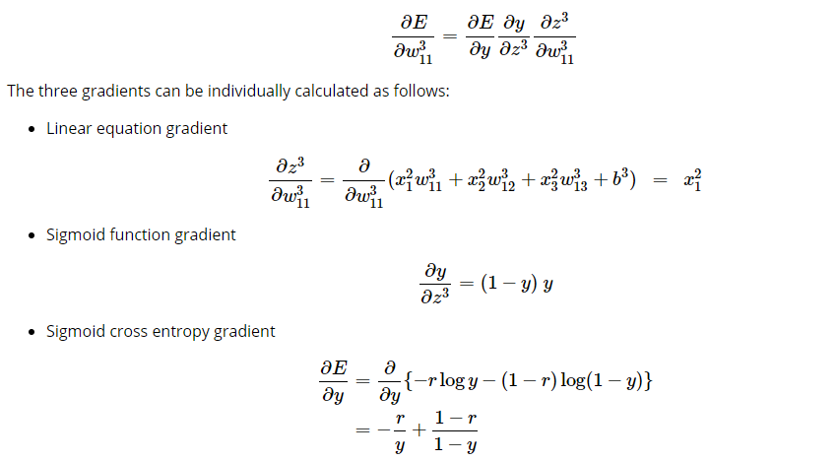

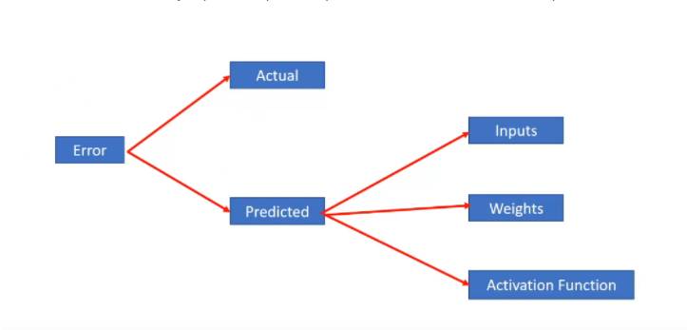
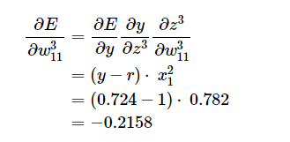
Backward Propagation
Notes:
Loss (output - y)2
Comparing actual vs predicted
mean squared error, binary cross entropy, Categorical Cross Entropy, and Sparse Categorical Cross Entropy
Derivation of the loss in respect to weight through chain rule makes top right
The derivative of the loss function over the weight of the node i equals the derivative of the loss function in respect to the activation function times the derivative of the activation function in respect to the input for node i times the derivative of the input to node i in respect to the weight
The sum of the three derivations is how backpropagation calculates the gradients of the loss in respect to the weights of the network
Next is gradient descent
So the old weight is subtracted from the arbitrary learning rate a which is determined beforehand much like the bias multiplied times the result of the chain rule calculation with the loss function. The result is the new weight. This is done until the local mininia is found

Slide 28

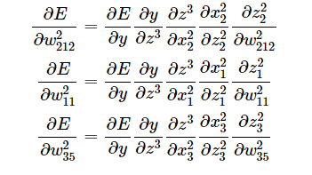
Backward Propagation Cont.

Slide 29
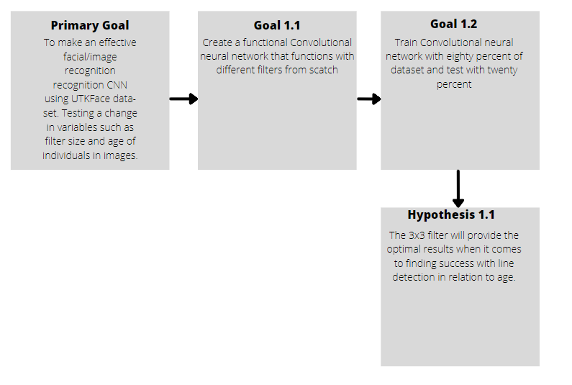
Goal Tree/Hypothesis
Notes:
https://www.canva.com/design/play?category=tADWs7ocEeY&type=TACQ-lCLuV8&uid=cb5ba6fd-406a-4847-ba9b-88a0eaea3658&_branch_match_id=934158736986938381&utm_source=landing-page&utm_campaign=decision-tree&utm_medium=graphs-pages&_branch_referrer=H4sIAAAAAAAAAwXB0Q2AIAwFwIkqJAJWE%2BMsD6jCh0gAnd%2B7NEbtm1IB5cN0i7oaauoUJeSen0KjiRxvjnvw1sOdkYx2IMNmIY%2FVEzO0QDA7yz9oUT%2FVTgAAAA%3D%3D

Slide 30
Experiment Design(old)
Develop and train a facial recognition CNN using the UTKFace dataset with varying filter sizes and edge detection kernel combination to determine which is the optimum setup for facial recognition for the trained CNN using some number of convolution layer and some number of hidden layer in classification stage of neural network. Using ReLU activation between convolution layers and sigmoid activation for the classification.

Slide 31
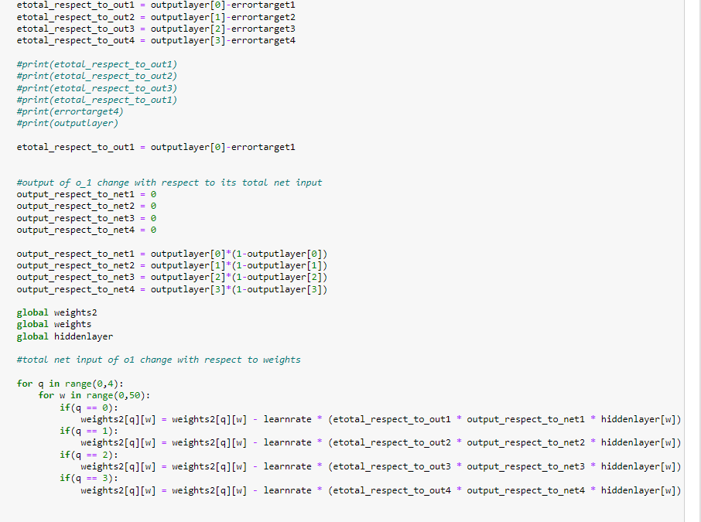

Slide 32
